Slide 1
Exam System
C# And .NET Project
Yam Elgabsi | 208698266
Dana Atias | 206354136

Slide 2
General Structure
Server Side | Client Side
Base on SQL Server with 3 tables: Users. Exams StudentExams | Every user can login to the app Teacher Create a new exams Edit & Delete is own exams. Show student solutions and grade statics. Student: Answer an exam. Admin: - Create & Delete Users.
Our project is divided to two solutions

Slide 3

Technology & Frameworks
Using .NET 6.0 with C#. Entity Framework packages: CORE, TOOLS, SQL SERVER

Slide 4
General Flow
Admin | Teacher | Student
Delete & Create Users | Create Exams Search Exams Edit & Delete is own Exams Save Exams & Questions on local Show student solutions and grade statics. Save student solution to exam. | Search Exams. Enter to exam. Show solution after the exam. Save the solution on local

Slide 5
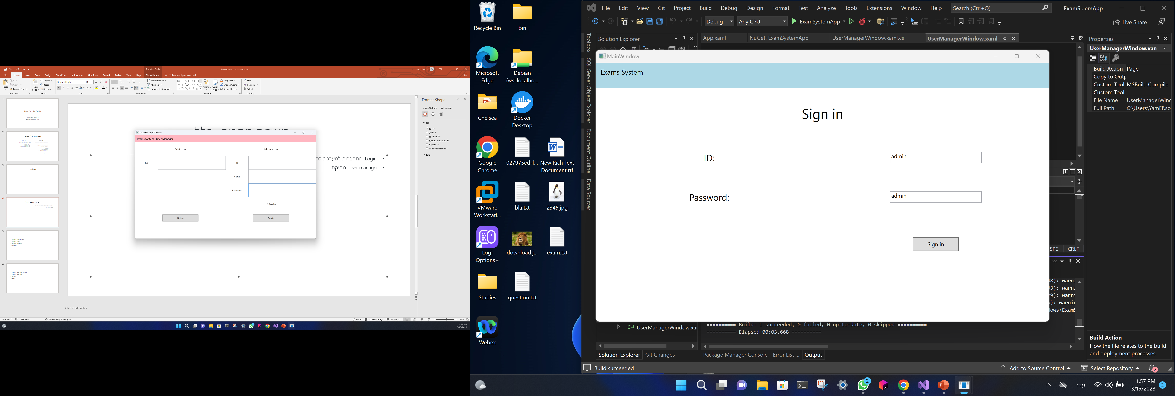
SCREENS
Sign in: Each user can login to the system with his ID and password. (admin’s id and password is admin)
User manager:
Admin’s screen to create & Delete User.

Slide 6
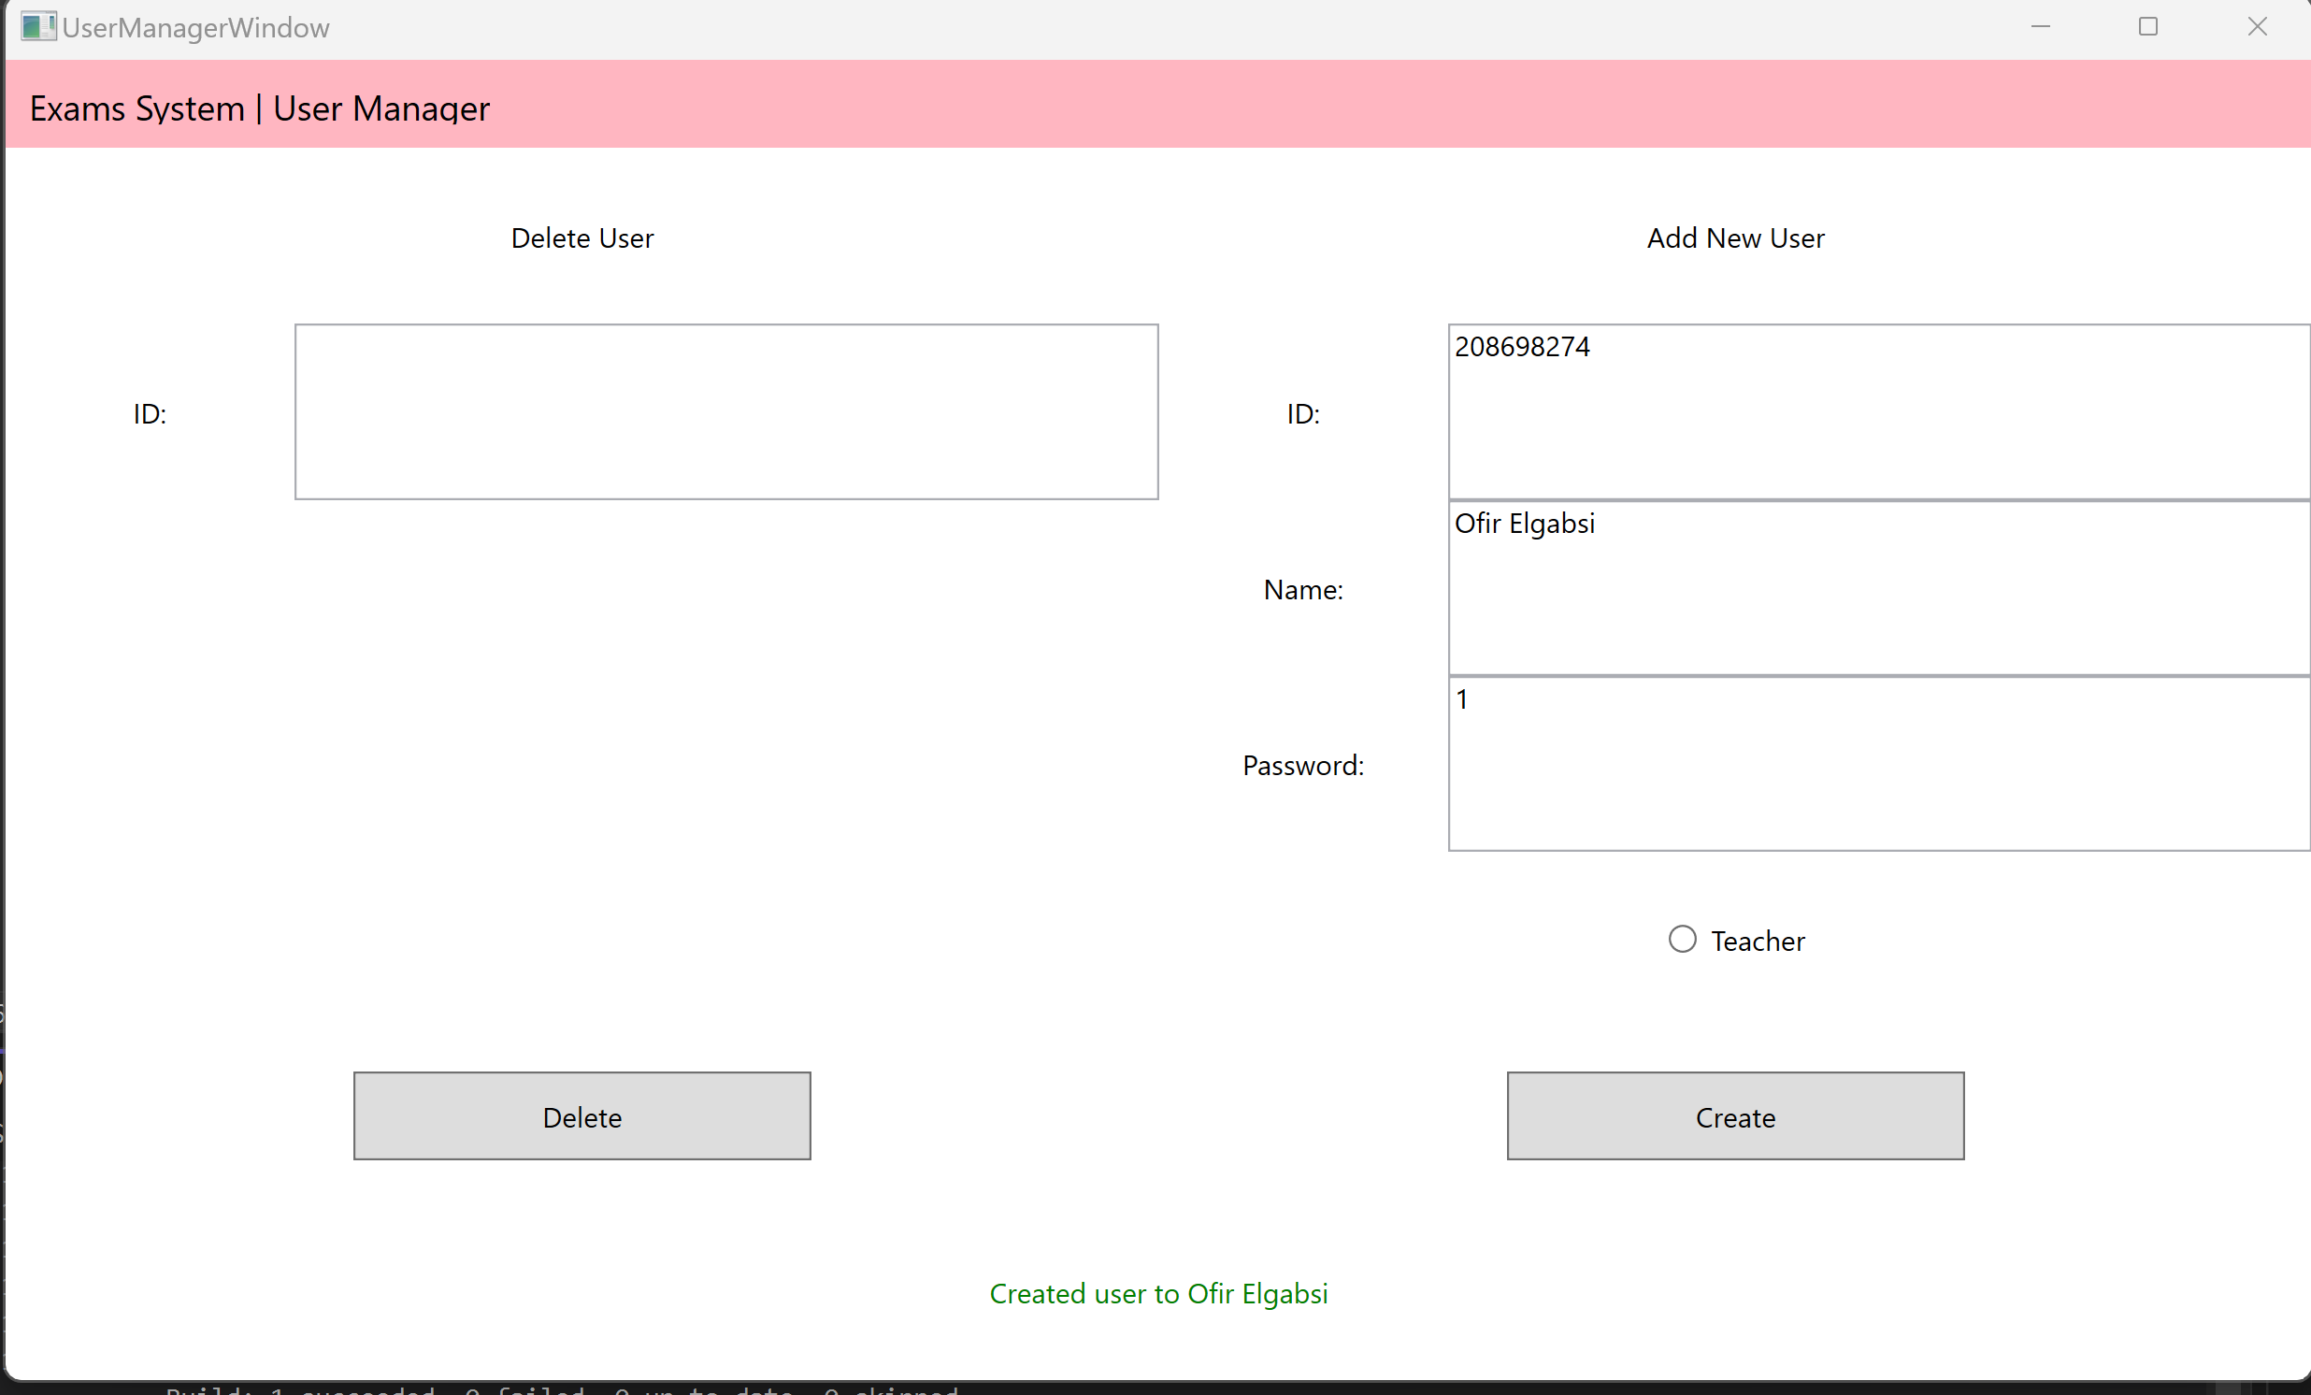
Admin screen- control users

Slide 7

SCREENS - STUDENT
Student
Students screen, Can search exam by name and enter it.
Student exam details
Student that select an exam can see his details. # the enter button is clickable when if the student is not already did the exams and enter to the exam in time (no later then 30 minutes)
Student exam When student successfully enter, the exam will show up. - each exam have timer, when finished its automatedly submitted.
Solution When student exam is submitted, the grade and solution with the correct answers shown up. The student have option to save his exam on computer as txt file.

Slide 8
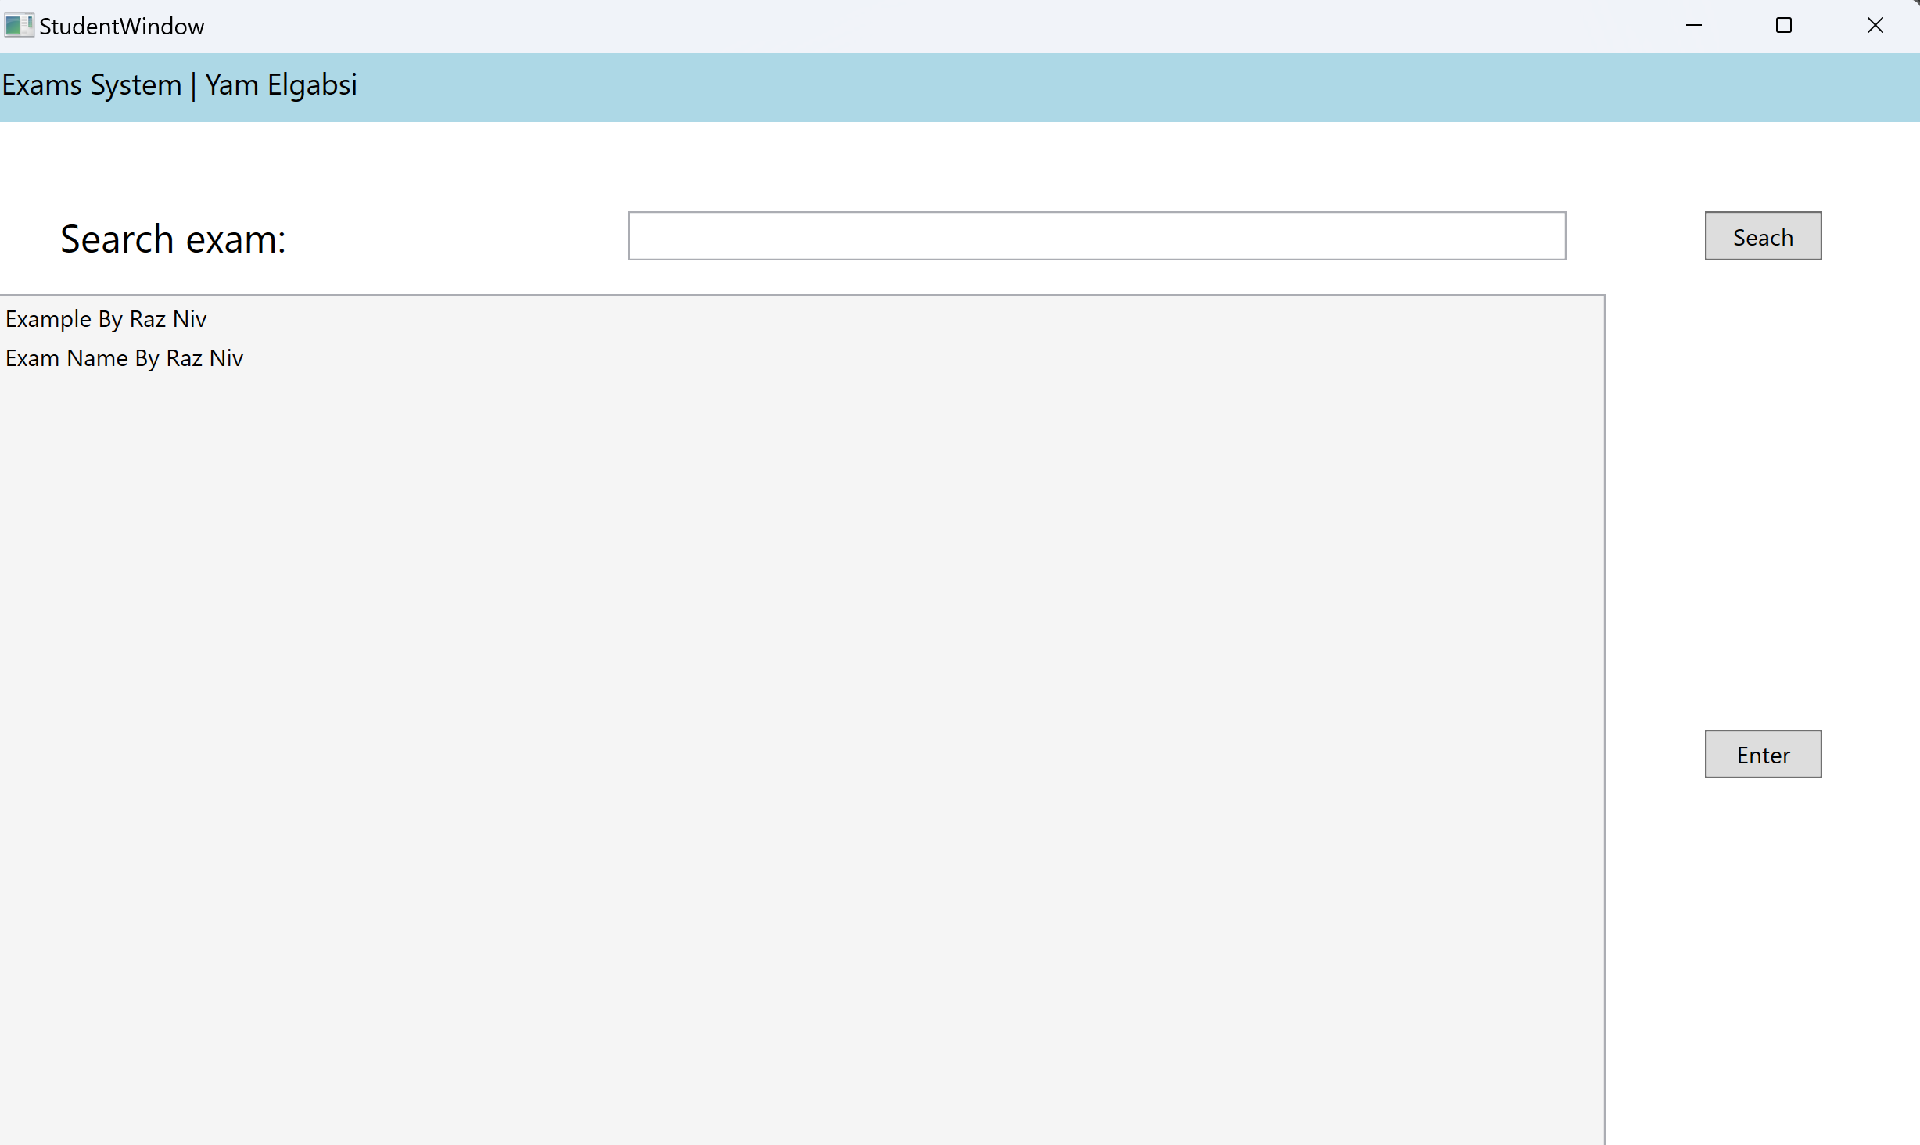
Students screen, Can search exam by name and enter it.

Slide 9
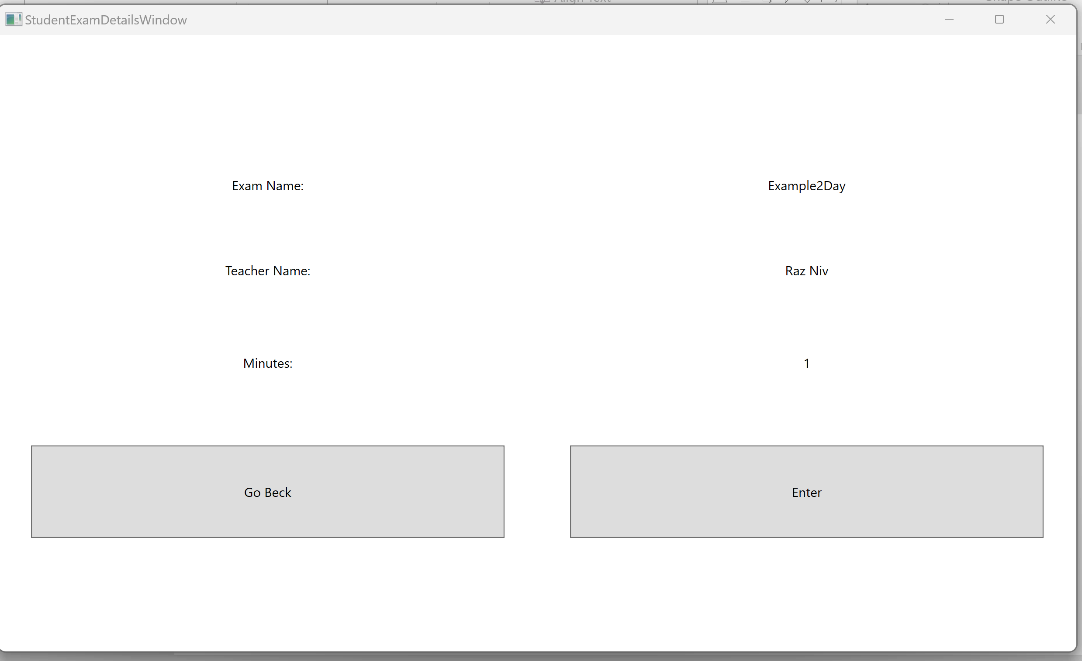
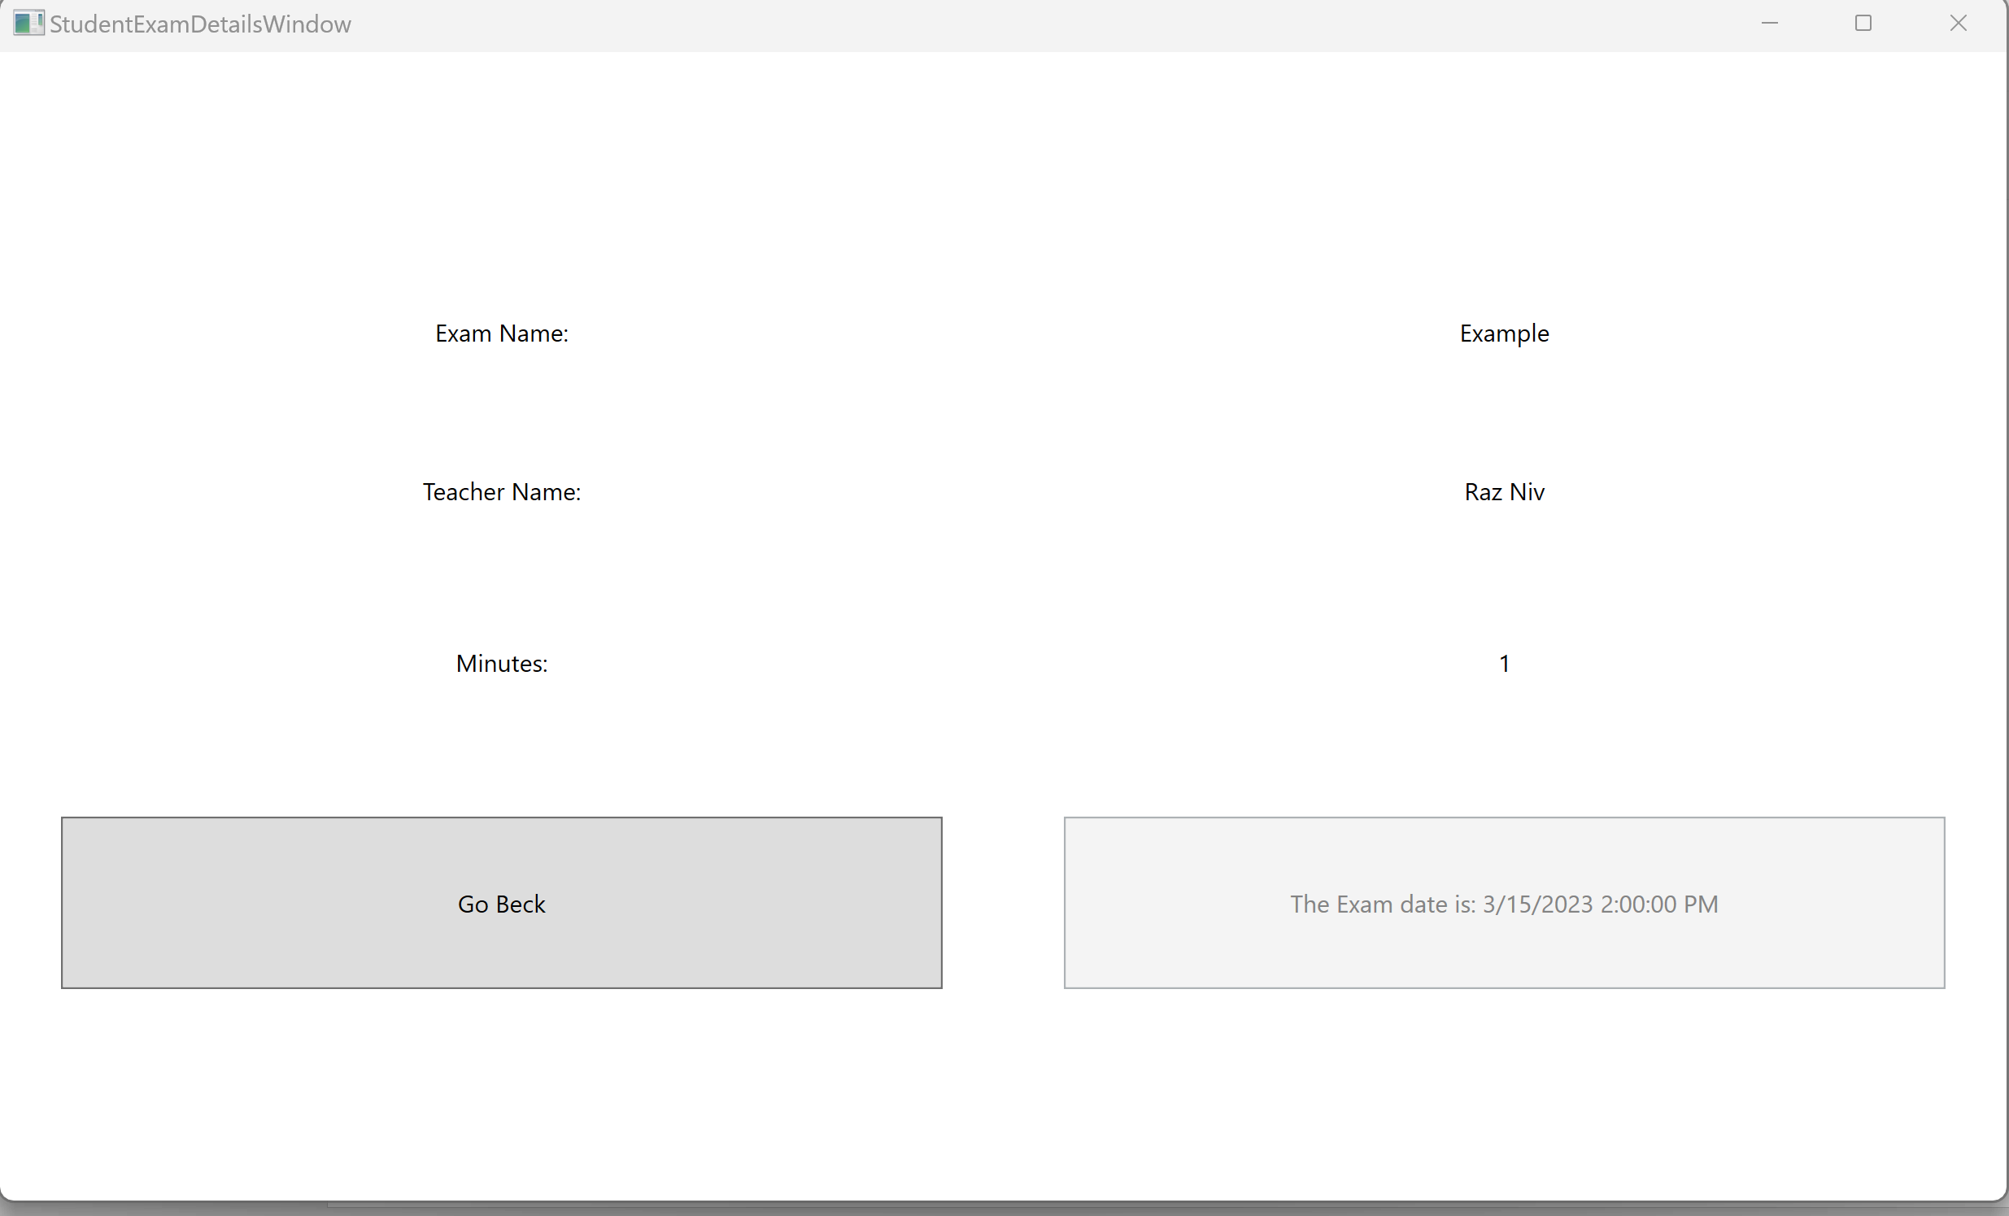
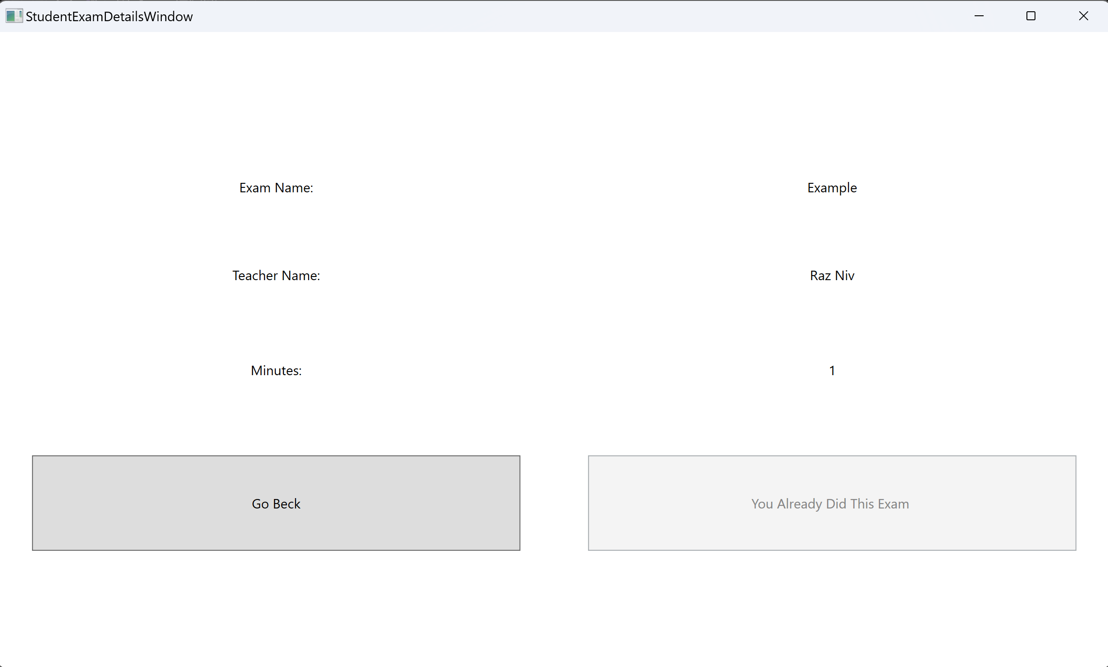
student- exam details screen

Slide 10
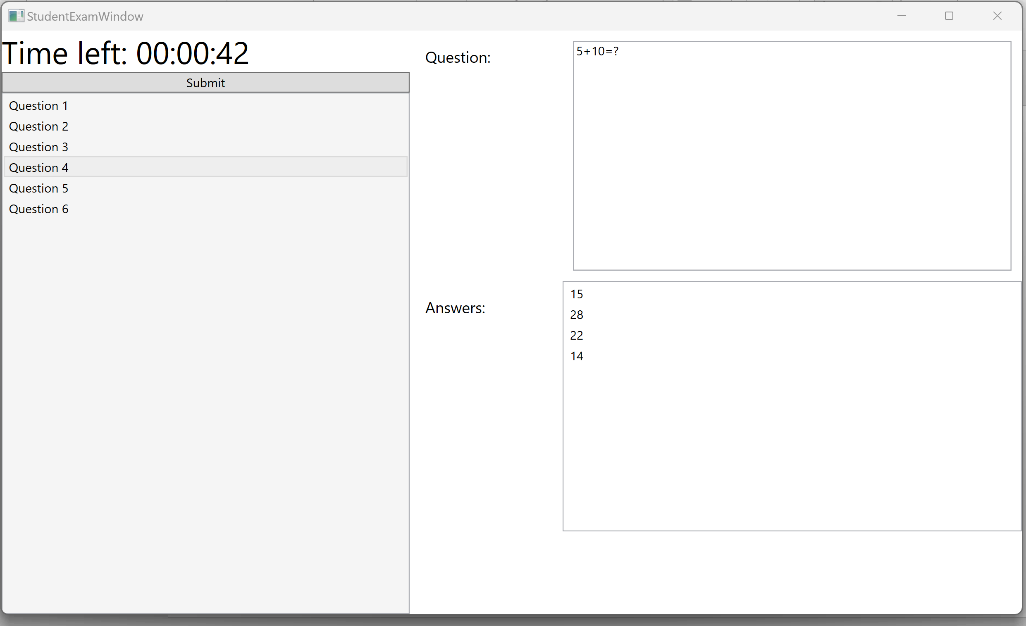
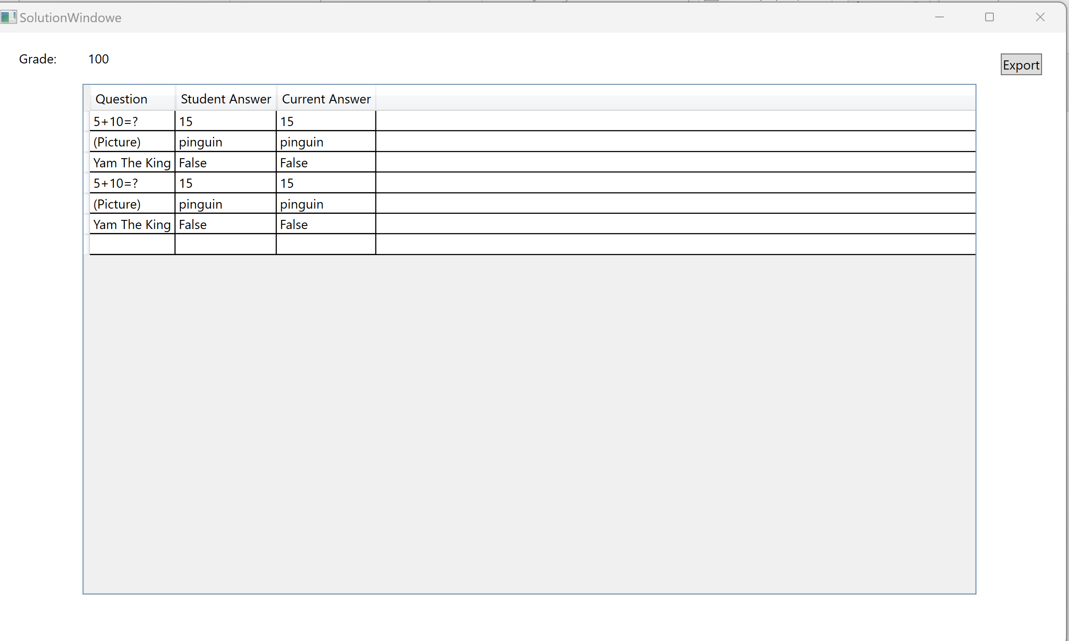
Exam screen
Exam results

Slide 11

SCREENS - TEACHER
Teacher
after teacher successfully enter the system,
he can see his exams and search exam by name.
Teacher new exam details
Teacher can create new exam or edit existing exam, in this window he can edit the exam information (like date, time…)
Teacher new exam in this window, the teacher creating new questions and answers or edit them.
Stats teacher can choose to see his exams statistics – avg, best grade , lowest grade and the exams itself.

Slide 12
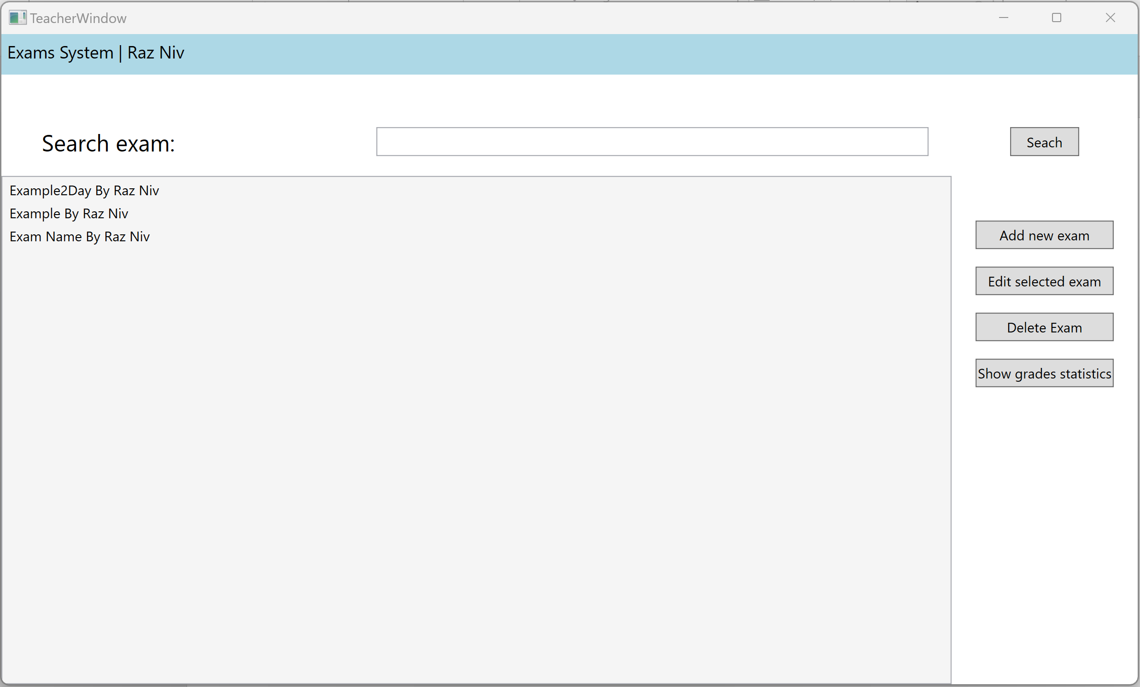
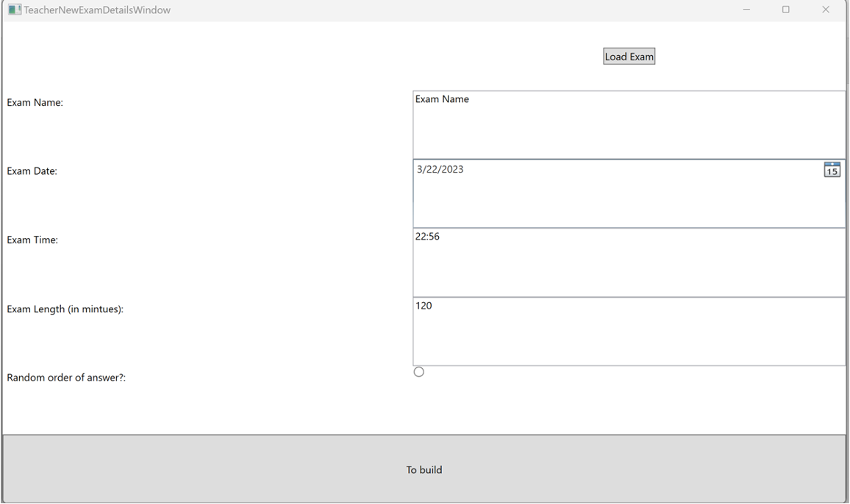
SCREENS - TEACHER

Slide 13
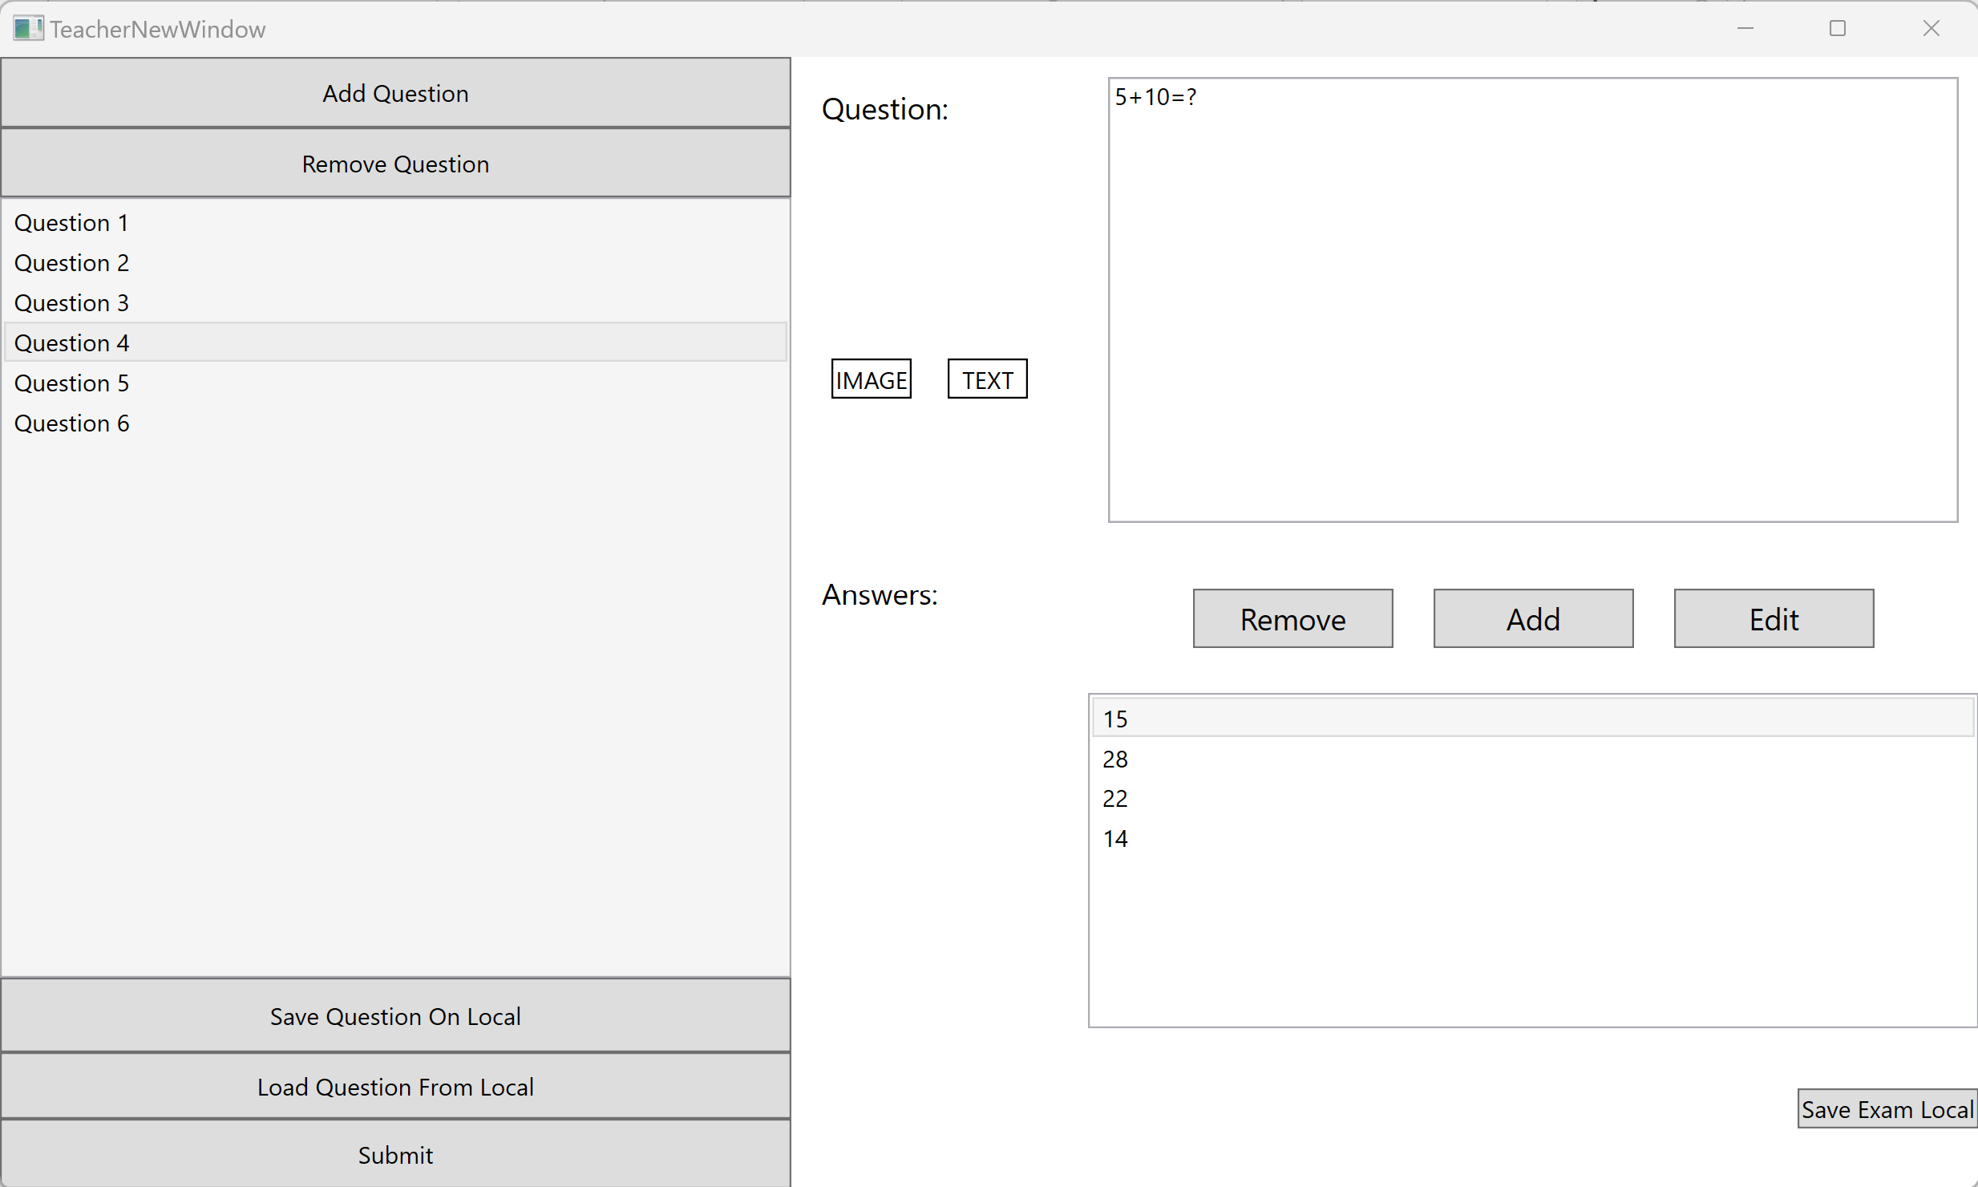
SCREENS - TEACHER

Slide 14
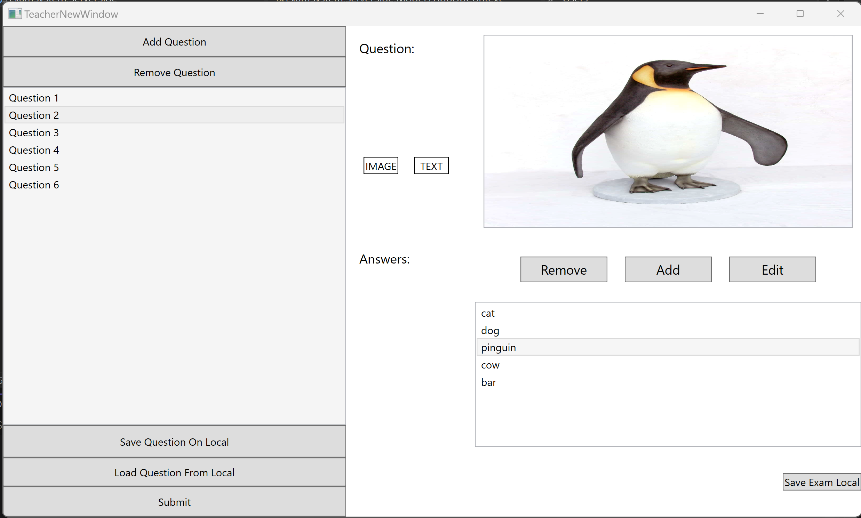
SCREENS - TEACHER

Slide 15
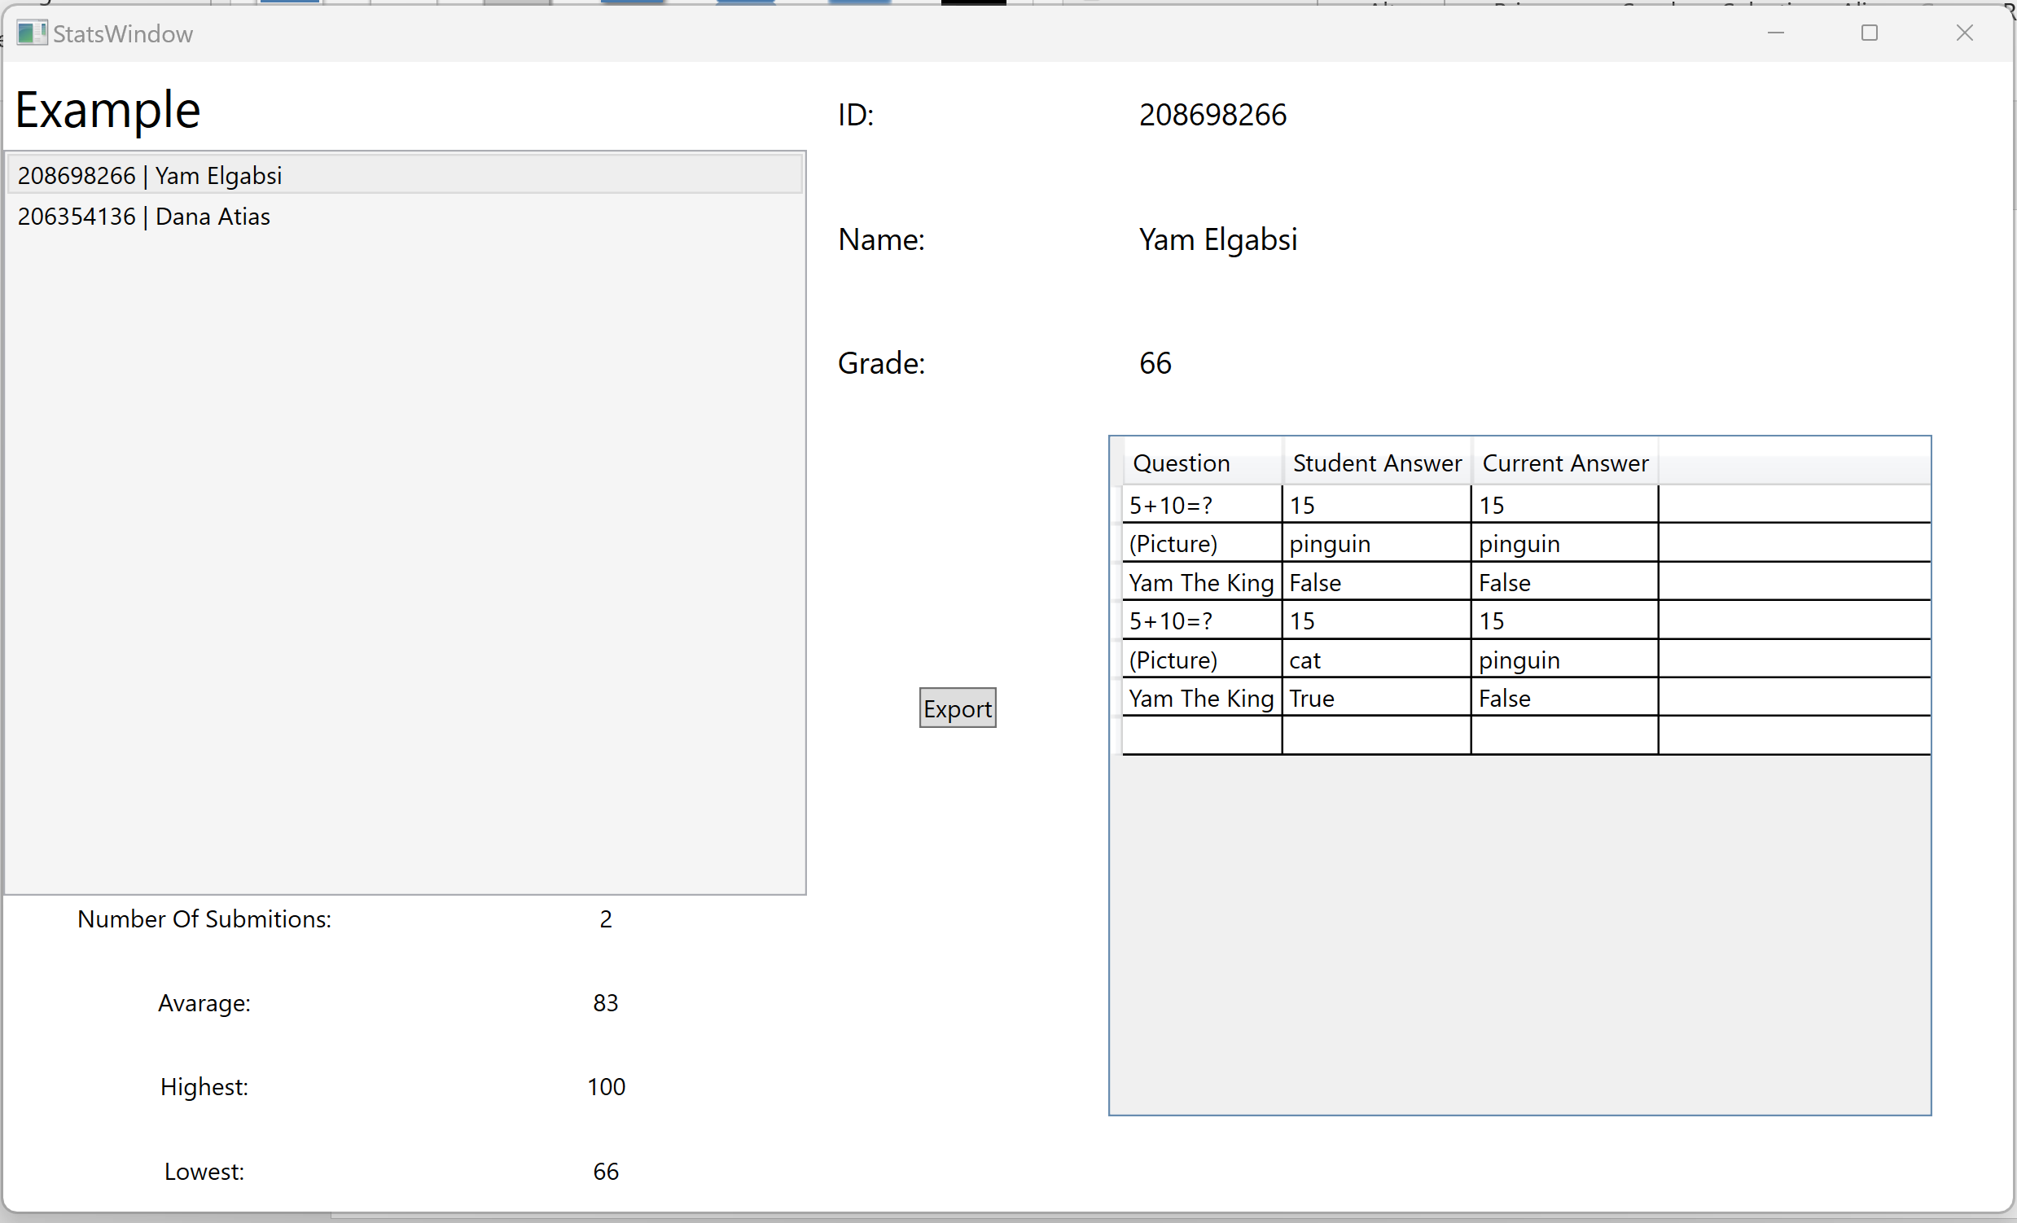
SCREENS - TEACHER

Slide 16
Database & Files
User
STRING ID
STRING NAME
STRING PASSWORD
BOOL ISTEACHER
Exam
string ExamId
string Name
TeacherID
string TeacherName
int Minutes
bool IsRandom
DateTime Date
string Questions
Database - SQL
3 tables:
Users (
Exams
StudentExams
StudentExam
string Id
string ExamId
string StudentId
string TeacherName
string StudentName
string TeacherId
int Grade
string Submission

Slide 17
helper Models
ExamSubmission
string Q - Question
string CA - Correct Answer
string SA - Student Answer
StudentExam Submission is a list of Json<ExamSubmission>
Exam Questions is a list of Json<Question>
If question is a picture the image saved as base64String
Question
string ExamId
bool IsPicture
string Q
string A
List<string> AllA

Slide 18
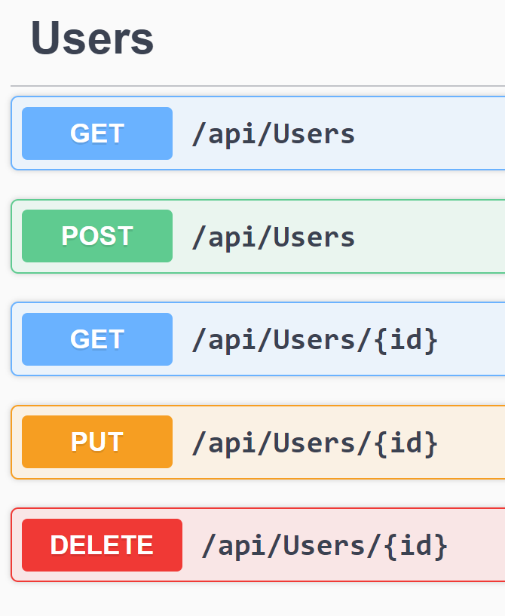
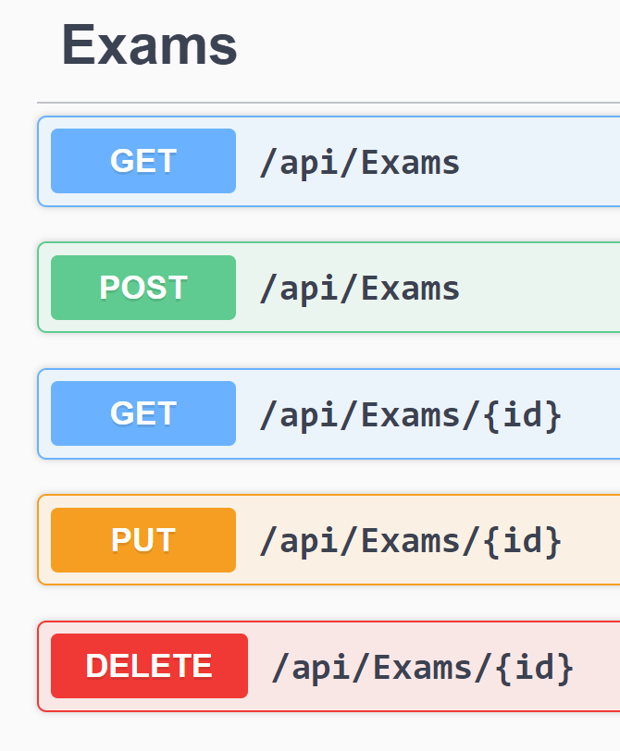
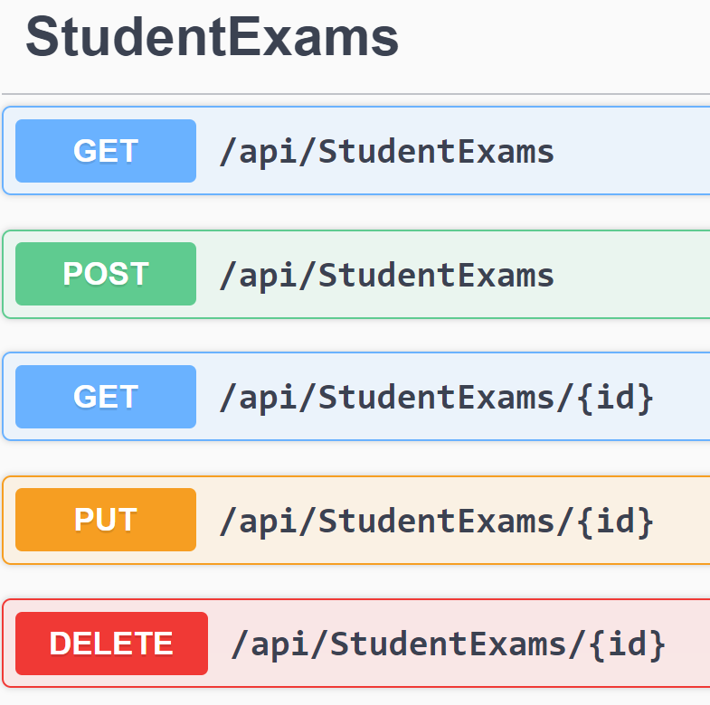
API Functions

